Slide 1

PROMOTING LAND & DELIVERING BUSINESS PARKS IN THE EASTERN REGION
Nic Rumsey, Managing Director

Slide 2
Jaynic are Land Promoters and
Business Park Developers
Infrastructure is key to all projects:-
  Roads, footpaths and cycleways
  Mains utilities – electricity, gas, water, surface water drainage, sewerage and fibre
  Framework landscaping
Delivered 14 phases of infrastructure with another phase in planning.
We have created 8 business parks 4 of those are in Suffolk - Gateway 14, Stowmarket, Suffolk Park, Bury St Edmunds, Haverhill Research Park and Haverhill Business Park.
All our developments rely on new local infrastructure to bring the site forward and create serviced development plots.

Slide 3
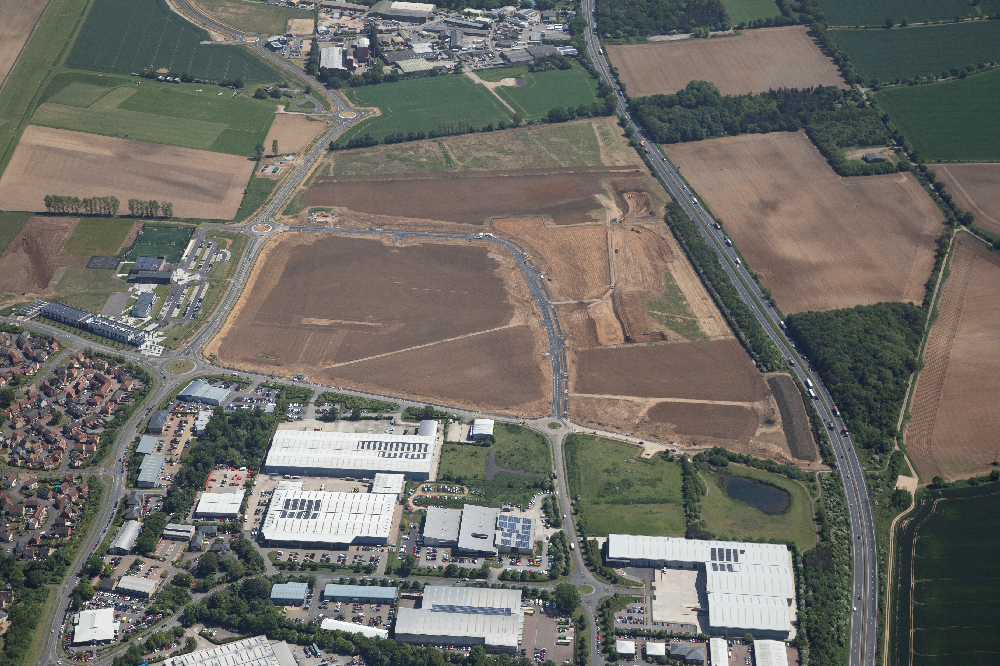
Suffolk Park, Bury St Edmunds
Upon completion of the eastern relief road at Bury St Edmunds, we put in £3m infrastructure to open up the whole of Suffolk Park.

Slide 4
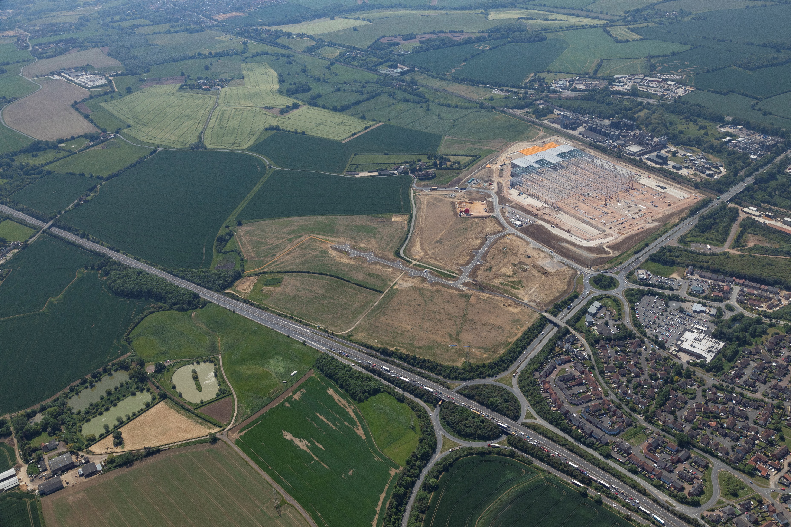
Gateway 14, Stowmarket
Part of Freeport East. 156 acres originally divided by adopted road:
  Closed Mill Lane, created estate road off the A1120 roundabout.
  Stopped traffic going through dense residential areas.
  Created more efficient development plots on the site.
  More footpaths & cycle routes created.
  However, it has been a complicated site to get fully energized.
  Growing pressure to make site as ‘green’ as possible but national grid cannot accept PV surplus as the infrastructure is not there!

Slide 5
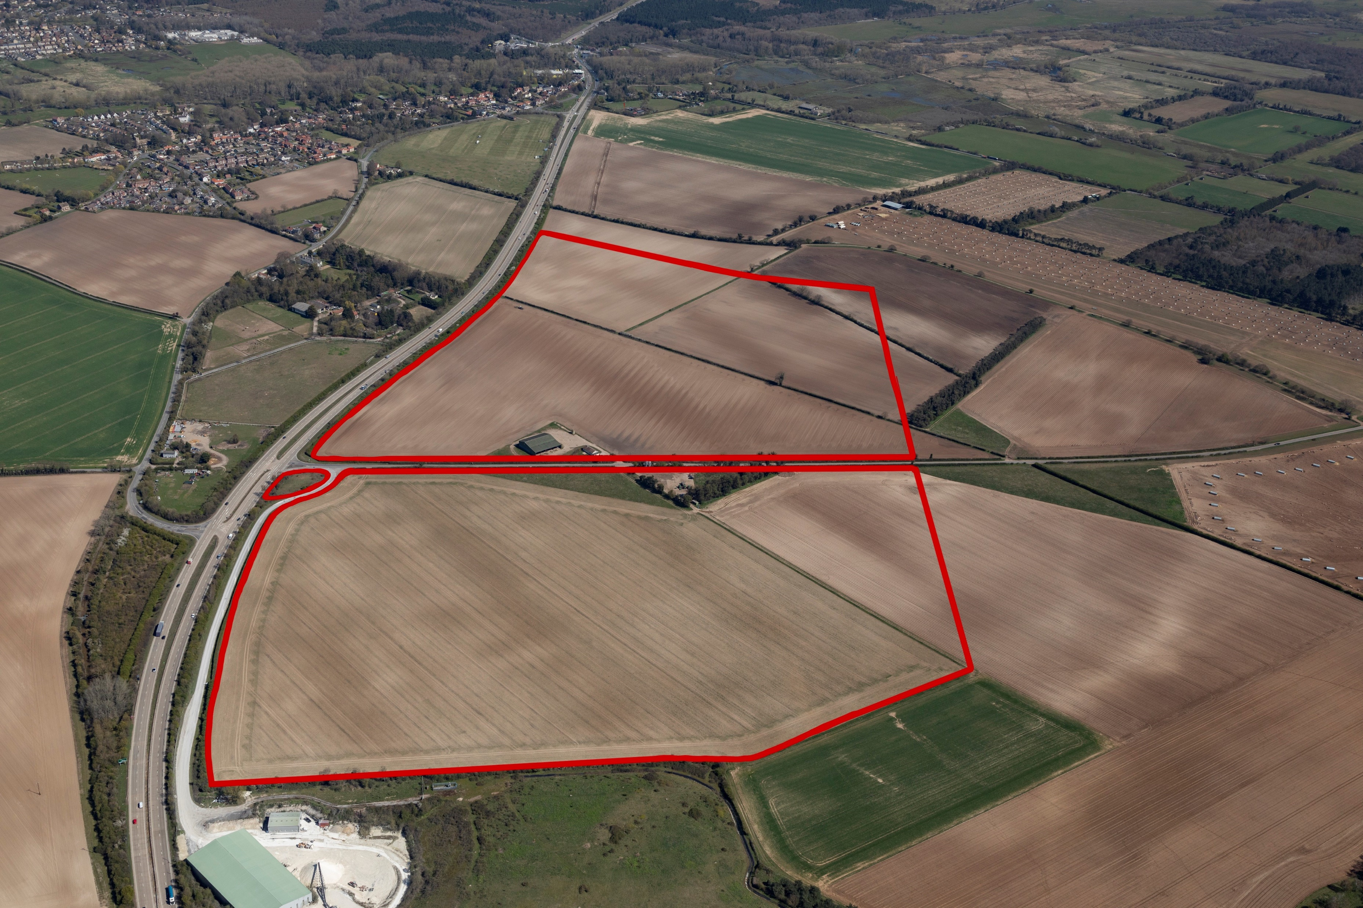
Our growth plans
We are currently planning two further business parks in Suffolk - Stanton Business Park and Stour Business Park, Little Wratting and promoting a third - A11 Business Park at Barton Mills.
A11 Business Park, Barton Mills

Slide 6
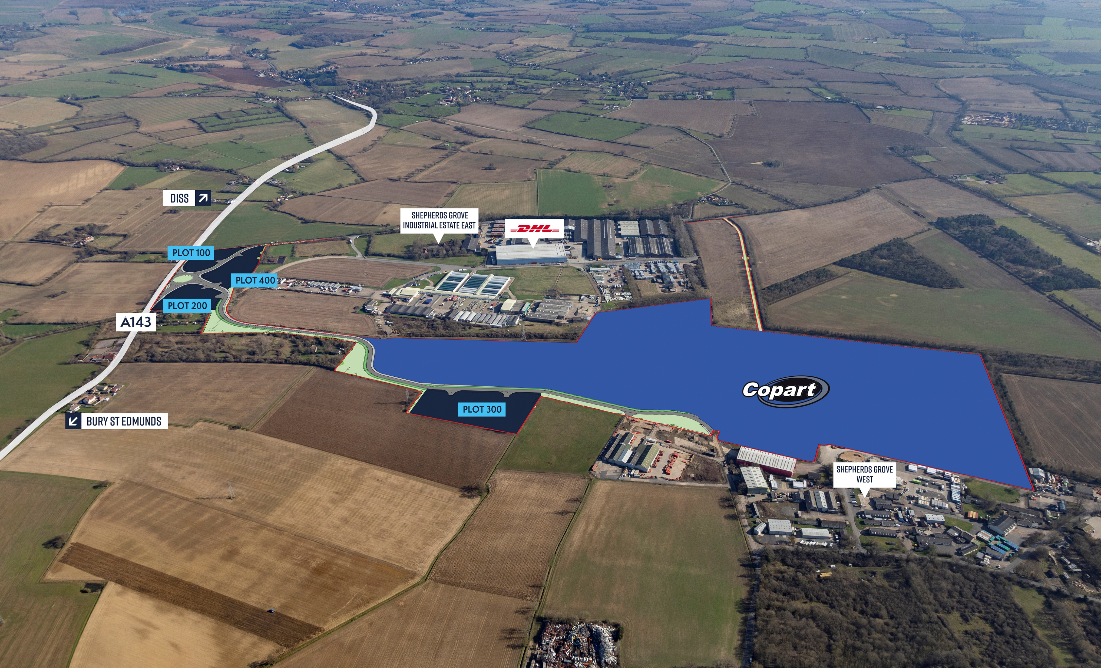
Stanton Business Park
    Subject to planning, Jaynic has agreed to sell 68 acres to Copart
    12 acres available for further development
    Hybrid planning application includes installation of roundabout on A143 and new estate road linking Shepherds Grove West (£9m)
    Removes need for large HGV’s/vehicles to drive through Stanton past local primary school.

Slide 7
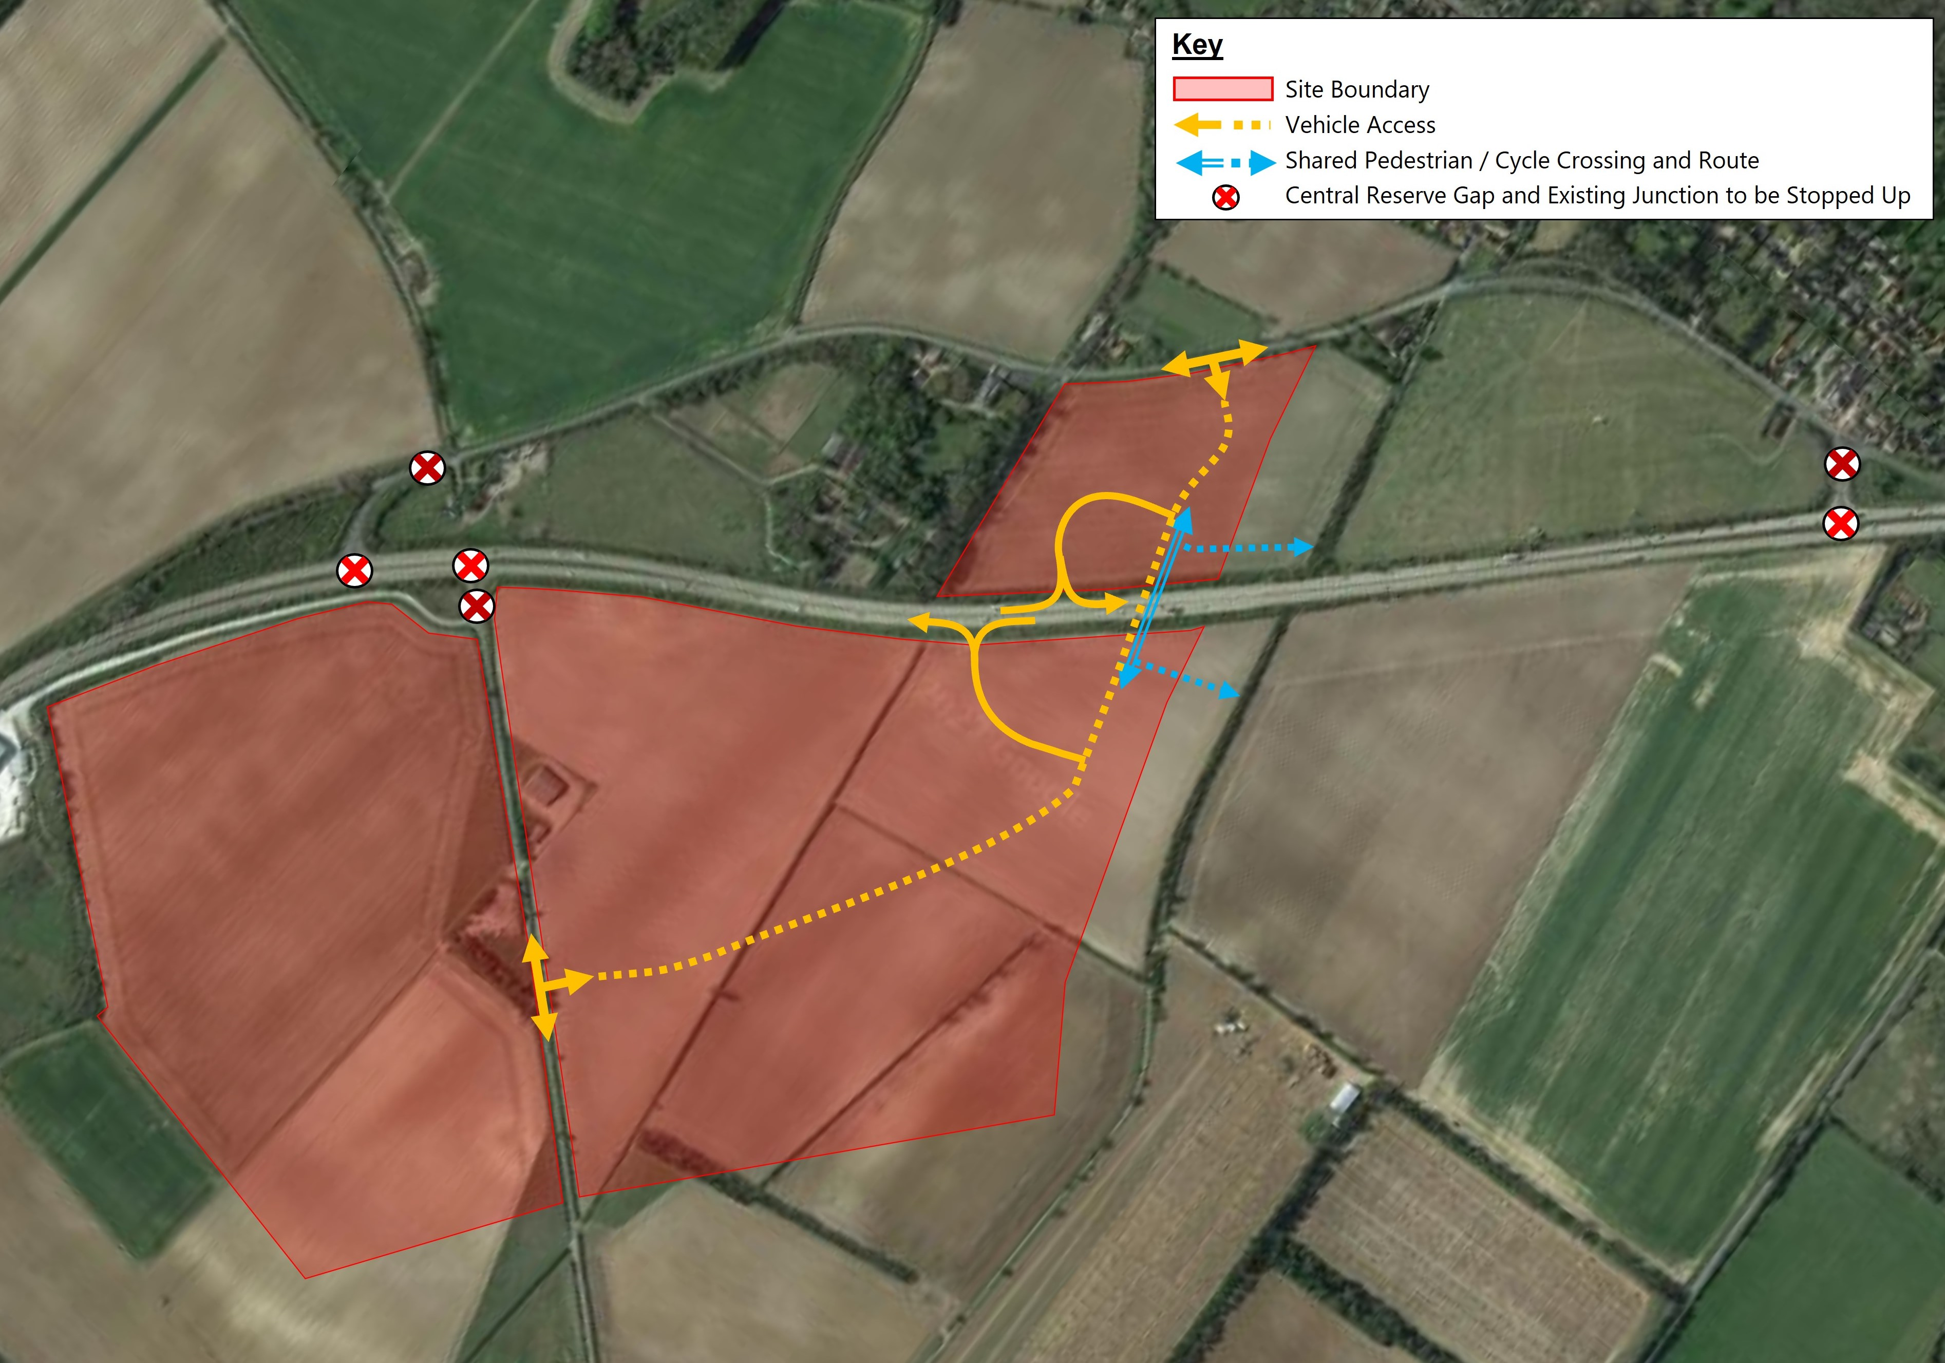
A11 Business Park, Barton Mills
    Agreement on 270 acres.
    Notorious vehicle and pedestrian accident black spot.
    Fulfills ambition of Norwich/Cambridge Growth Corridor Employment Land proposal.
    Jaynic includes plans for a grade separated junction on the A11.
    Complements recent National Highways proposals.
    Could play a part in creating new ‘All Directions’ A11/A14 junction.

Slide 8
Our vision for better infrastructure in Suffolk
Number 1 Priority:
  A proper ‘All Directions’ A11/A14 Junction
    West Suffolk Solution:-
      Creation of a link between proposed Barton Mills interchange and Junction 40, A14, bypassing Tuddenham.
      Would massively enhance the Eastern Powerhouse!

