Slide 1
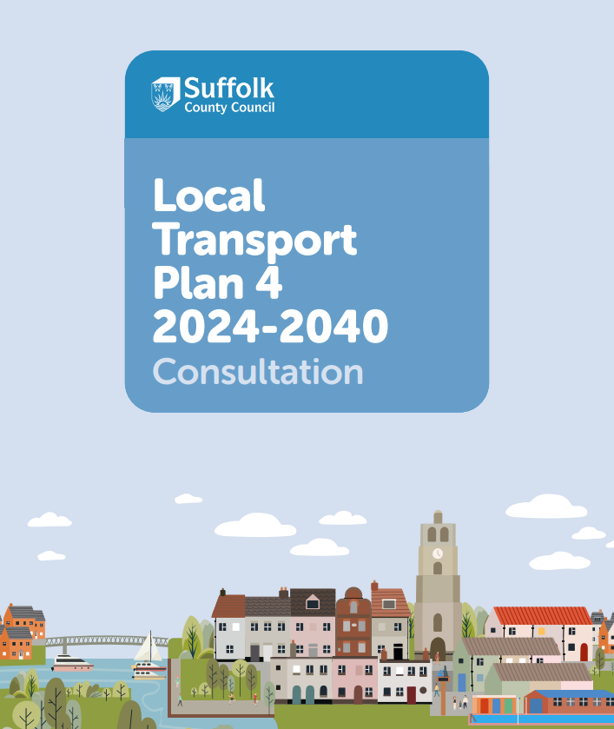
Local Transport Plan 4 (LTP4) consultation
Luke Barber
Strategic Transport and Policy Manager

Slide 2
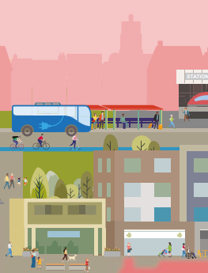
What is the LTP4?
The Local Transport Plan (LTP) is the key document which sets out a long-term vision for transport in Suffolk
This consultation is on the fourth version of the LTP and will cover the period to 2040

Slide 3




Key Themes
Decarbonisation of Transport
A strong, sustainable and fair economy
Health, Wellbeing and Social inclusion
Creating better places

Slide 4
Decarbonisation of Transport
Helping residents to make fewer trips, through; spatial planning to reduce the need to travel, connecting communities to the services they rely on
Shifting to more sustainable modes
Improving the take up of low carbon fuels
Shifting a greater proportion of freight to rail

Slide 5
A strong, sustainable and fair economy
Influence National Government, through Transport East, to secure rail and strategic road improvements in Suffolk
Support freight to adopt lowest carbon transport opportunities, reflecting the key UK role of Felixstowe Port
Build upon Suffolk’s unique qualities to attract visitors and spread prosperity throughout Suffolk

Slide 6
Health, Wellbeing and Social inclusion
Improve access to active travel options and access to the countryside and natural greenspace, to encourage the physical and mental health benefits for residents
Provide a range of transport options to all communities
Improve air quality in Suffolk, focusing on areas where transport related air quality is shortening lives

Slide 7
Creating better places
Focused interventions in the key strategic towns
Improve bus services in Suffolk and integrate the network better with other complementary modes
Including climate change mitigation and providing biodiversity net gain
Improving road safety across Suffolk

Slide 8

Key Strategic Interventions
Improving rail connectivity throughout the region, through rail improvements to the key routes
Securing funding from National Highways for key strategic road projects at A12/A14 Copdock and A11 Fiveways and pushing for further investment in the key A14 junctions at Bury St Edmunds and Newmarket. Delivering the Major Road Network schemes on the A12 and A140

Slide 9
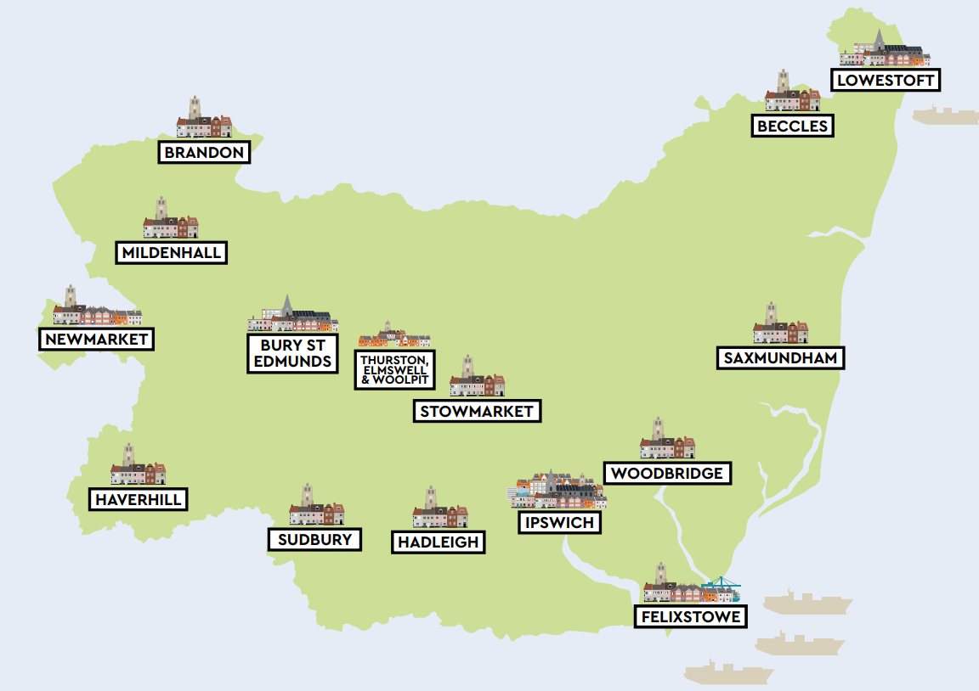
Strategic Areas
Covering the largest towns, key growth locations, and economic centres
Alignment with the Transport East key settlements and Connectivity Study areas
A more diverse set than previous LTPs
Each area will have its own Local Strategy and Implementation Plan

Slide 10

Key Urban Local Interventions
Delivering substantial and transformative cycling, walking and wheeling improvements, as set out in the Local Cycling and Walking Infrastructure Plan (LCWIP)
Deliver bus service improvements to; reduce journey times, improve service reliability, increase passenger numbers and improve passenger satisfaction
Traffic capacity improvements to unlock plan led growth

Slide 11

Rural Interventions
Providing transport options to minimise social isolation for communities
Delivering public transport improvements as part of Suffolk County Council’s Bus Service Improvement Plan (BSIP) and the development of Community Rail Partnerships (CRPs) throughout Suffolk
Ensuring the natural environment for rural communities is maintained for the benefit of all

Slide 12

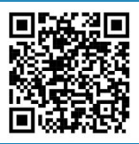
Take part in the consultation www.suffolk.gov.uk/LTP4

Slide 13
Next Steps
Consultation is running from 12 February 2024 and will run for 8 weeks
So far, we have received over 800 responses
The results of the consultation will feed into the drafting of the LTP4 Part 1 and Area Implementation Plans
DfT requires a list of potential interventions in time for the ‘next government’, but nobody (other than Rishi Sunak) knows when that will be…
We are anticipating a further round of consultation on the full document in Autumn 2024

Slide 14
Thank you for listening
Any Questions?

