Slide 1
Menopause & Me
A project delivered by Suffolk Libraries in partnership with Suffolk Mind
Beth Fisher
Menopause & Me project co-lead

Slide 2
The Story So Far…
Department for Health & Social Care – VCSE Health and Wellbeing Fund 2022-2025
Coproduction December 2022-March 2023
Launch
Notes:
*SL, with SM as primary delivery partner applied to the DHSC VCSE Health & WB fund, last summer.
*The fund, for this cycle, is focused on Women’s Reproductive Wellbeing in the Workplace
*We were pleased to find out we’d been awarded funding Dec last year * We are one of 16 projects from the country awarded funding. Other grant recipients include: Tommy’s Wellbeing of Women, Endometriosis UK & Fertility Network UK
*Projects range in focus, relating to women’s health, and ours is one of a handful focussed on the Menopause, with a particular emphasis on working with SMEs as well as people with lived experience. (more on that later)

Slide 3
Co-Production Activity Consultation aims - to understand: 1. Current levels of knowledge and understanding of (peri)menopause 2. Impact of (peri)menopause (particularly on career and the workplace)
3. Support needs - what is already in place, what else is needed, and what format should this take? Lived Experience: “You are made to feel inadequate for finding symptoms affecting your ability to deliver on work demands in some jobs. There is an expectation you will just get on with it.” “I had a mental breakdown and changed career as a result of peri-menopausal anxiety and depression.” “Trouble with sleep impacted most areas of my life at the time - work, social occasions, relationships. My mental health really deteriorated until this was resolved - with time and adaptations.”
“I took early retirement as I felt that I couldn’t continue in my stressful managerial role. I had brain fog, exhaustion and anxiety. I couldn’t sleep, couldn’t concentrate and generally couldn’t cope.”
Notes:
* We obviously had a basic project structure in mind (again more later) but what is important to us, and the success of the project, is that we deliver what people want.
*So between January & March this year we joined forces with Cohere arts to undergo a period of research and co-production with local SME employers and people with lived experience. The aims of this consultation were to gain greater depth of understanding, to help us design project content, as detailed here.
* In total we had 232 respondents to our surveys and focus groups, this was heavily weighted to those with lived experience, not from want of trying! * The positive is that, from the engagement we had with SMEs, a broad range of industries were represented including: HR consulting, higher education, Insurance and financial services, arts & culture, horticulture, legal, charities, museums, business support and manufacturing. * The details of the findings are a whole other presentation (and should be reflected in the design of the project), but here, and on the next slide, are a few things we heard from people..

Slide 4
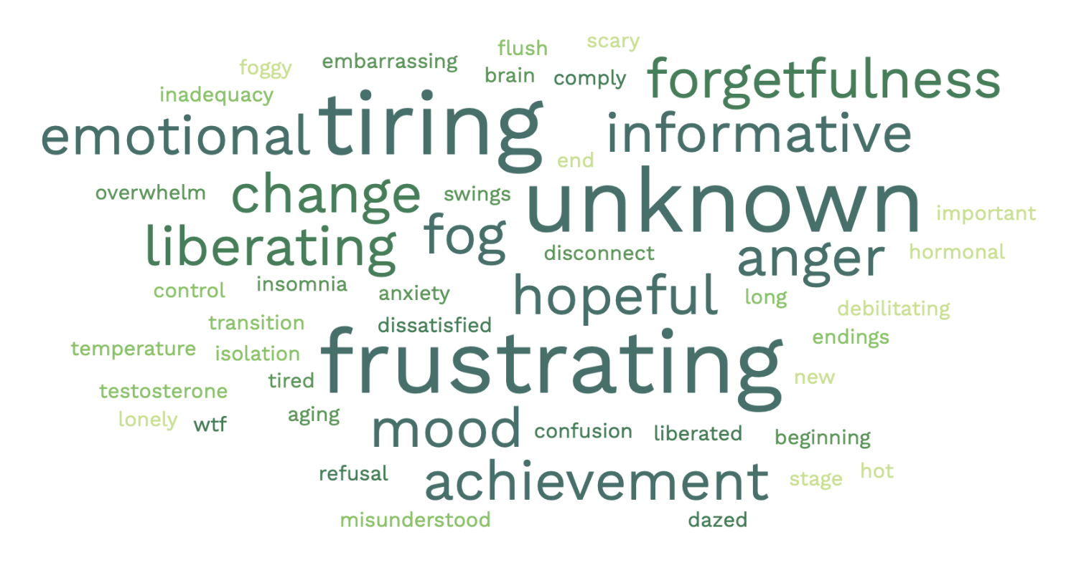
Co-Production Activity
Employers: “Several staff are reaching a point where the (peri)menopause is starting to affect them, and our organisation is more female than male…We need to understand it to be able to support them further.”
“We need buy in from all staff - despite this issue affecting over half our staff at some point in their lives - it is not seen as a priority.”
Three Words to sum up your (peri)menopause experience
Notes:
We took on the findings from the Coproduction report and associated recommendations and launched our project on 23.03.23 at ITFC.
It is also important to note, at this point, we are working to be as inclusive as possible with this project. During our development period, we have made adaptations to our communication tools, for example, making web content translatable to many languages. We have worked with ThinkInclusive to review our copy and make recommendations, helping us remove jargon, using plain English and remain as inclusive as possible.
It is also important to note that for the purpose of this project, we may refer to ‘women’ but Suffolk Libraries recognises this project and its outputs apply to transgender and non-binary people. The project is inclusive of all people who might experience the menopause. Our intention is never to cause offense with the language we use but if we do inadvertently cause offense, we invite people to let us know, because we are always keen to learn and improve.

Slide 5
The Project
SME Employers Employers Pledge Fully Funded Training with Suffolk Mind (Peri)menopause Policy Open & Honest Conversation
People with Lived Experience Fully Funded six module course with Suffolk Mind M-Powered Groups Work Well Support with Suffolk Mind (one year only) Both Employers and People With Lived Experience Resources Recommended reading Useful links
Notes:
The project is designed with three core strands:
Support for SMEs (fewer than 250 employees and annual turnover of under 50mil Eruos) * Support for People With Lived Experience * Resources for All
This is what each strand looks like. I’ll now talk through each one in a bit more details

Slide 6
SME Employers The Menopause & Me pledge is intended to not only serve as an act of commitment to support colleagues experiencing the menopause, but it is also an opportunity to access support and resources to help you do this.
Through recognising and supporting people experiencing menopausal symptoms in your workplace, business can benefit by:
Promoting themself as a desirable employer with an age and gender inclusive workforce
Retaining a skilled and experienced workforce
Employing a workforce who feel supported and in return demonstrate increased engagement and loyalty
Reducing staff turnover and associated expenses
Promoting their organisation as one which operates non-discriminatory practice(s) and is against gendered ageism.
By signing the pledge, employers are not only demonstrating their commitment to their own staff's wellbeing but can showcase this publicly by being added to our virtual wall of pledged partners and by including the Menopause and Me stamp on their own website.
Sign our Employer’s Pledge and show the world that you are an organisation who cares for, supports and wants to retain valuable members of your team.
Notes:
Research by the Fawsett Society (2022) tells us that one in 10 women who have been employed during the menopause have left work due to menopause symptoms. Our own findings tell us what whist employers often have some awareness of symptoms, they don’t always have an understanding of the impact this can have on absence, staff turn over and career progression.
* Now, we recognise that SMEs don’t always have the resources, HR departments, Occupational Health, Employee Assistance programmes etc. that larger organisations and their employees often have access to.
Therefore, they have tough choices to make when deciding how best to use the resources they do have (if any), so to remove barriers to supporting colleagues experiencing the menopause in their workplaces, all the support tools available through Menopause and Me are fully funded by this project.
The first thing is we have created a Menopause & Me pledge. If an SME signs up to the pledge, they are committing to:
When you sign the pledge, you commit to:
Send a staff member to attend free menopause online training with Suffolk Mind (subject to availability)
Implement a workplace menopause policy – template available on our website
Create a menopause-friendly workplace and facilitate open and honest conversations on the subject.
When employers sign up, we will host their logo as a link on our website, highlighting them as a local menopause friendly employer.
Employers can sign up to the pledge (and associated training) on the website

Slide 7
Employers Training
Dates available:
Tuesday 5 December, 9.30AM - 4PM
Wednesday 31 January 2024, 9.30AM - 4PM
Wednesday 13 March 2024, 9.30AM - 4PM
Sign up via our website – https://www.suffolklibraries.co.uk/advice/health-and-wellbeing/menopause-and-me/employer-pledge
Notes:
The free employers training will focus on raising awareness of the menopause and how its impact and associated symptoms can be supported and managed within the workplace.
This training will support SME to become a more menopause-friendly work environment, offering guidance to employees and providing techniques to support staff. The training will help employers confidently manage conversations around the menopause with colleagues and put policies into practice.
** approx. 40 employers have already signed the pledge and attended the free training (4 training sessions).

Slide 8
People with Lived Experience Courses Each session will focus on different areas of information and support. The six sessions facilitated by Suffolk Mind are:
Session 1 – What is the Menopause?
Session 2 – Managing Symptoms
Session 3 – Menopause & Sleep
Session 4 – Managing Anxiety
Session 5 – Building Your Support Network & Resources
Session 6 – Reflection: Putting Everything into Practice
Sign up to courses via our website – https://www.suffolklibraries.co.uk/advice/health-and-wellbeing/menopause-and-me/suffolk-mind-menopause-course
M-Powered Groups Chantry Kesgrave Gainsborough Mildenhall Stowmarket Newmarket
Notes:
* Again, we’ve teamed up with Suffolk Mind to develop a free to access course to help people better understand their symptoms and how to support themselves.
Each session will focus on different areas of information and support. The six sessions facilitated by Suffolk Mind are listed here:
Courses take place online. We are currently fully booked until June 2024, however we have a waiting list. We are still encouraging people to sign up though the website. Over 50 people on waiting list – demonstrates the need for this support. Approx 83 people have completed the courses so far (9 courses).
We have also set up M-Powered Groups within 6 of our libraries. M-Powered Groups are dedicated safe spaces for anyone to come and talk to like-minded people about their experience with the menopause. Meet new people, share experiences and find support, encouragement and understanding from others over a cuppa. These groups are currently hosted at these libraries, and we are looking to add more in the coming months.
Finally, people with lived experience of the menopause support through their Suffolk Work Well programme. This is a free support programme that can be individually tailored to meet your needs and aspirations, and to help facilitate your transition towards employment or to retain employment. This 1-1 support will be available to support and guide participating women retain, regain and/or return to work. Information and self referals can be made on the Suffolk Mind website.

Slide 9
Resources
For Employers
For people with lived experience
For Everyone
Notes:
Throughout the duration of the project we are drawing on feedback from our consultation and participants to pull together helpful resources, information and signposting, which are hosted on the SL website.
For example, we have already referenced the template policy for employers to use, but there are also other useful tools, for example, Support Checklists for employers, and a glossary of terms. We have recently added Information on types of HRT available and a symptom checker. We also have recommended reading lists (all books that are available to borrow though the library) and useful links to additional credible sources.

Slide 10
Help Us Spread the word!
https://www.suffolklibraries.co.uk/advice/health-and-wellbeing/menopause-and-me
Beth Fisher – Co-Project Lead, bethany.fisher@suffolklibraries.co.uk
Nicole Smith – Co-Project Lead, nicole.smith@suffolklibraries.co.uk
Jane Cox – Community Mental Health & Wellbeing Manager, jane.cox@suffolklibraries.co.uk
Notes:
All project information, sign up forms and resources can be found on our website. You can also contact one of us for a chat about any element of the project, we’d love to hear from you! Please help us spread the work so we can support as many Suffolk residents as possible…oh, and there are badges, tote bags, pens and certificates for employers…who doesn’t love these?!

