Slide 1
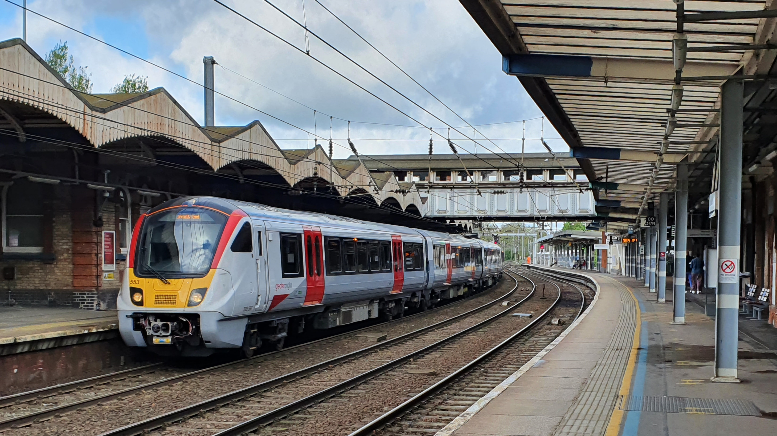


Rail Plan Update

Slide 2


Contents
Introduction to Transport East
Transport Challenges
Strategic Vision and Priorities
Rail Plan
Rail Leadership Group
State of Rail Report
Next Steps - Proposed work Programme

Slide 3
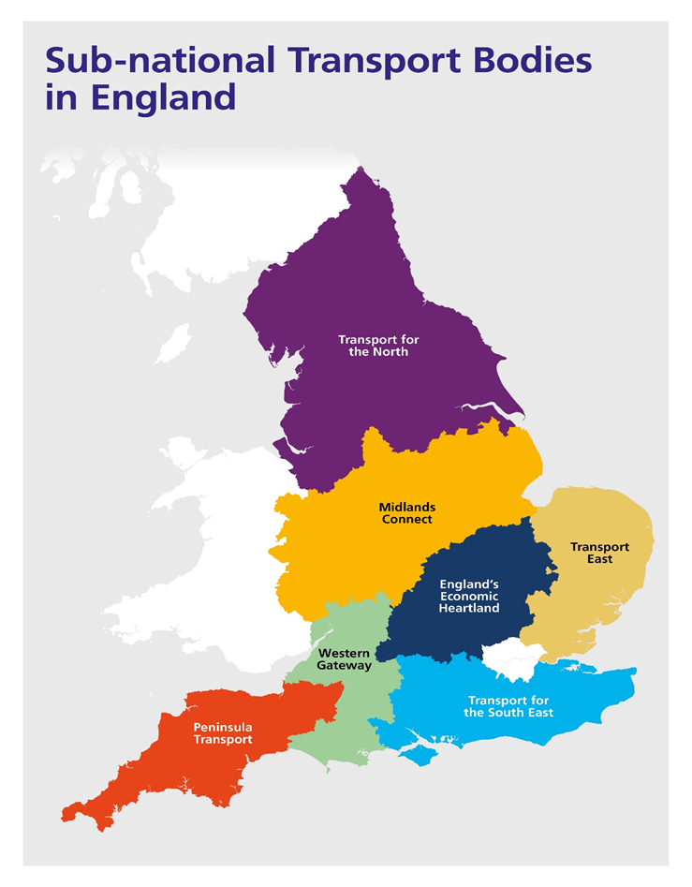
Transport East
Transport East:
  Norfolk, Suffolk, Essex, Thurrock and Southend
  Partnership: Local Transport Authorities, Planning Authorities, LEPs, Chambers of Commerce, National Highways, Network Rail and DfT
Our role:
  Speak with one voice on transport
  Create Transport Strategy for region
  Prioritise strategic investment
  Accelerate and improve delivery
  Support partners – capacity and capability

Slide 4
Core feedback
Transport challenges
The East helps drive the UK economy:
75 towns and cities
Strong, innovative and diverse economy
Global gateway for trade
Energy sector powering the country
Major housing and jobs growth
But has major transport challenges:
Rising emissions
Poor connectivity and congestion
Rural and coastal accessibility
Accessing international gateways

Slide 5
Vision and priorities
“A thriving Eastern region with safe, efficient and net-zero transport networks advancing a future of inclusive and sustainable growth for decades to come”
Strategic priorities
Decarbonisation to net zero
Connecting our growing towns and cities
Energising coastal and rural communities
Unlocking our international gateways

Slide 6
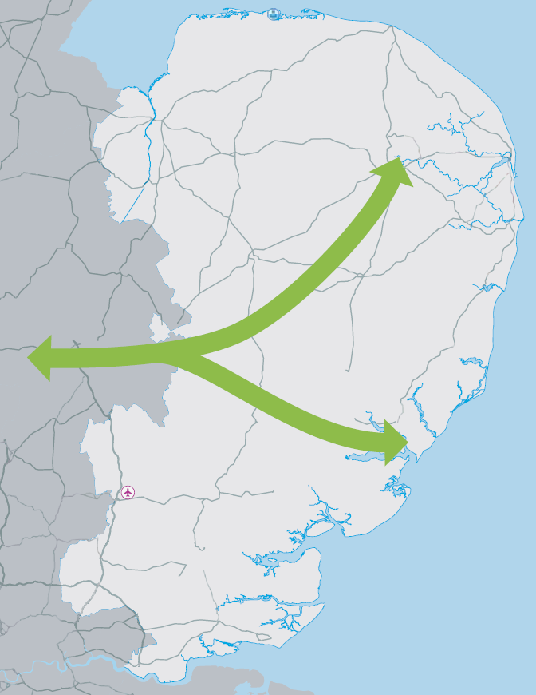
Why do our partners want a Rail Plan?
EW Rail Eastern Board
A single voice for Rail:
Set Rail Vision for entire region
Outputs and Outcomes
Strategic case for investment
Short, medium, long term priorities
Integration with multi-modal regional strategy / LTPs / BSIPs / NH
Provide direction/ co-ordination for better partnership working
Provide regional advice to government on rail investment in the East
Ely task force
Trowse area Rail Group
WAML task force
GEML task force
Existing Rail Task Forces in the East

Slide 7
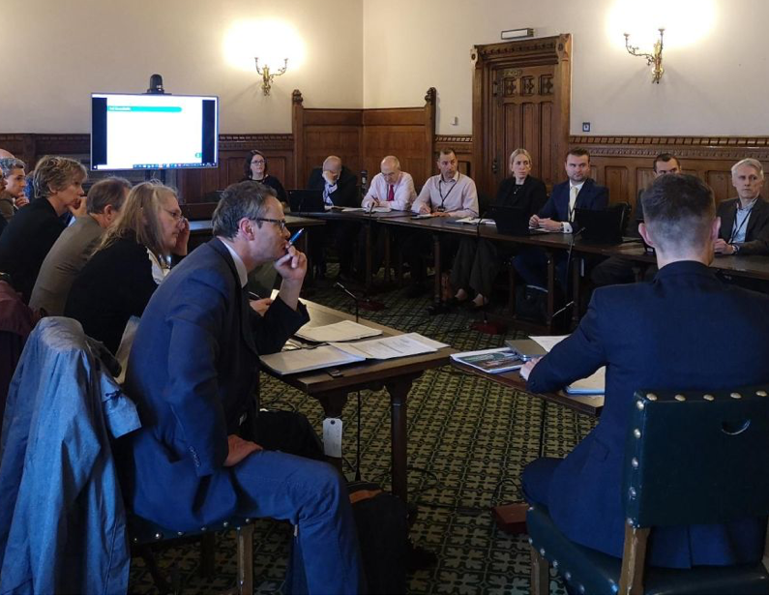
Rail Leadership Group
Participants
Key points:
Formed November 2022
Brings together rail groups across the East into one to create single Rail Plan
Terms of Reference completed Jan 2023
Hosted Parliamentary reception with Huw Merriman MP on 27th February
Peter Aldous MP, Co-chair EoE APPG
Lord Haselhurst, Chair, WAML task force
Giles Watling MP, Chair, GEML task force
Cllr Nicoll, Chair EWR Eastern Board
Industry partners: Network Rail, GBR TT, Greater Anglia, C2C, Rail Freight Group, NIC
Transport Authorities / STBs: Norfolk, Suffolk, Essex, Thurrock, Southend, Herts, CPCA, England’s Economic Heartland

Slide 8
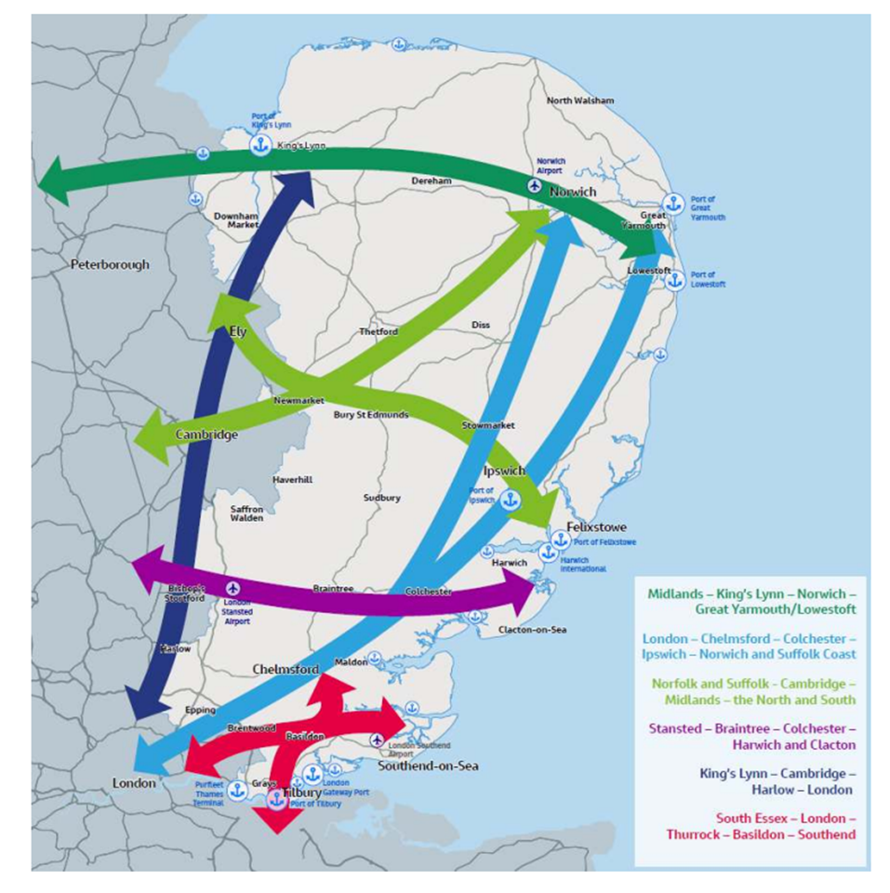
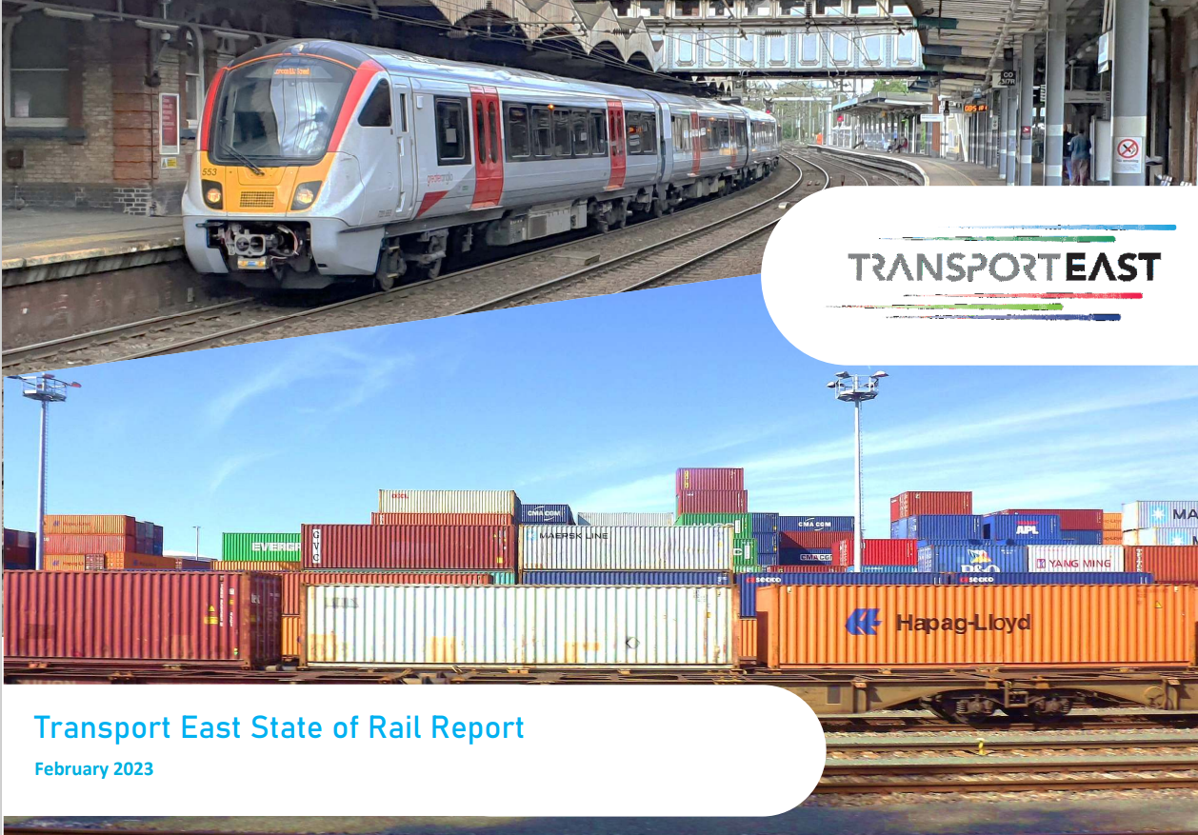
Overview
State of Rail Report
First stage: Initial ‘State of Rail in the East’ report published February 2023.
Line by line & network review of issues, challenges and current evidence against our six core movement corridors and Transport Strategy goals
Transport East Strategy:
6 strategic corridors: People and freight

Slide 9
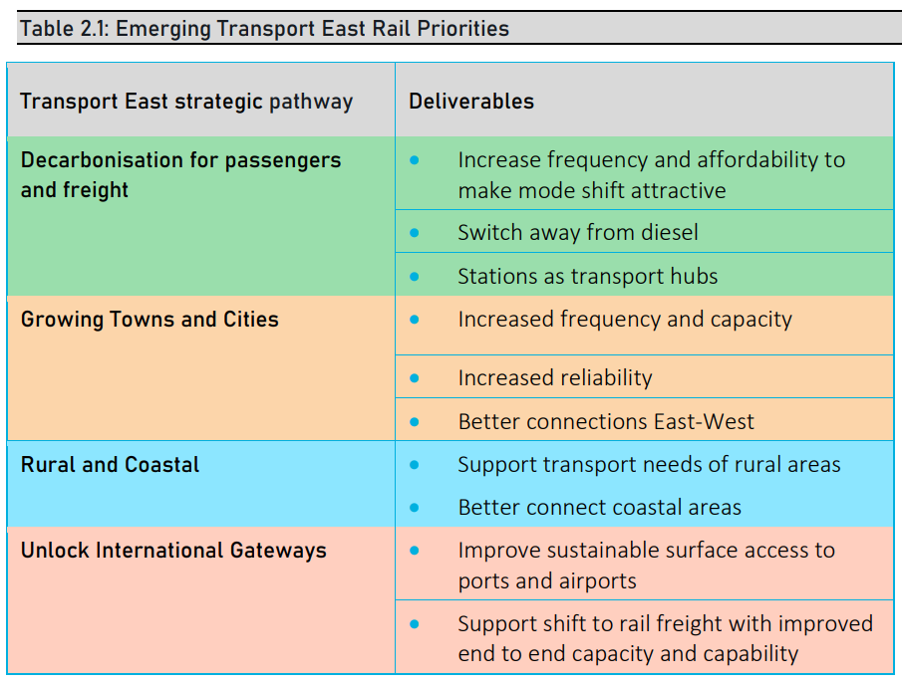
Strategic outcomes for rail
State of Rail Report
The study identified for our Strategy pathways the priority outcomes that rail needs to deliver in the East.
Detailed analysis / evidence base provided on constraints / issues for each corridor

Slide 10
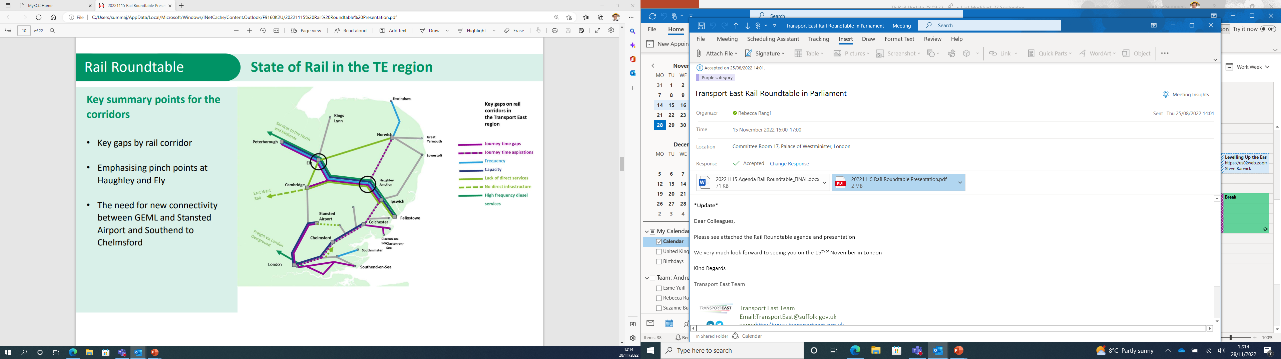
Challenges
State of Rail Report
Five strategic challenges:
Poor East-West connectivity
Poor Inter-urban connectivity (both within region and to rest of UK)
Poor Frequency
Restricted freight movement
Limited access to airports
Current ‘State of Rail’ in the East

Slide 11
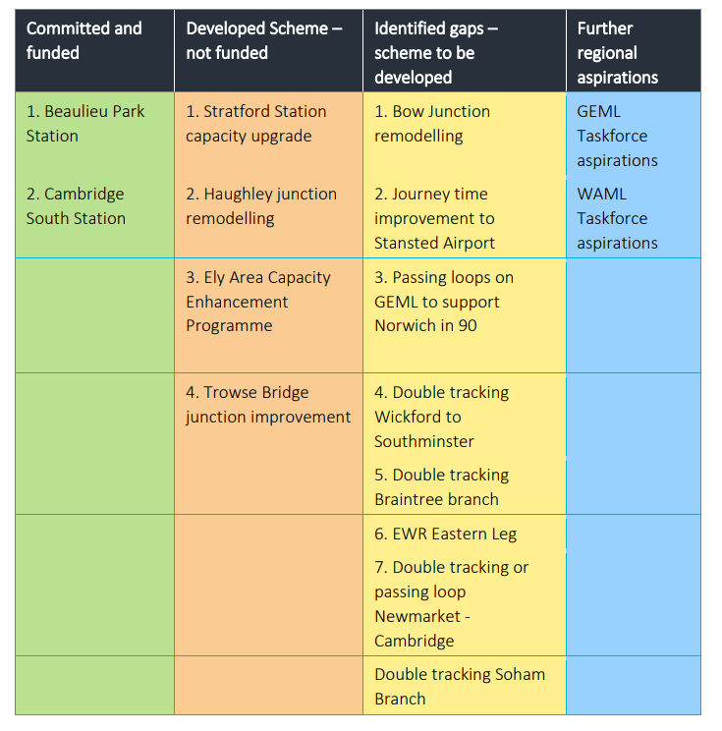
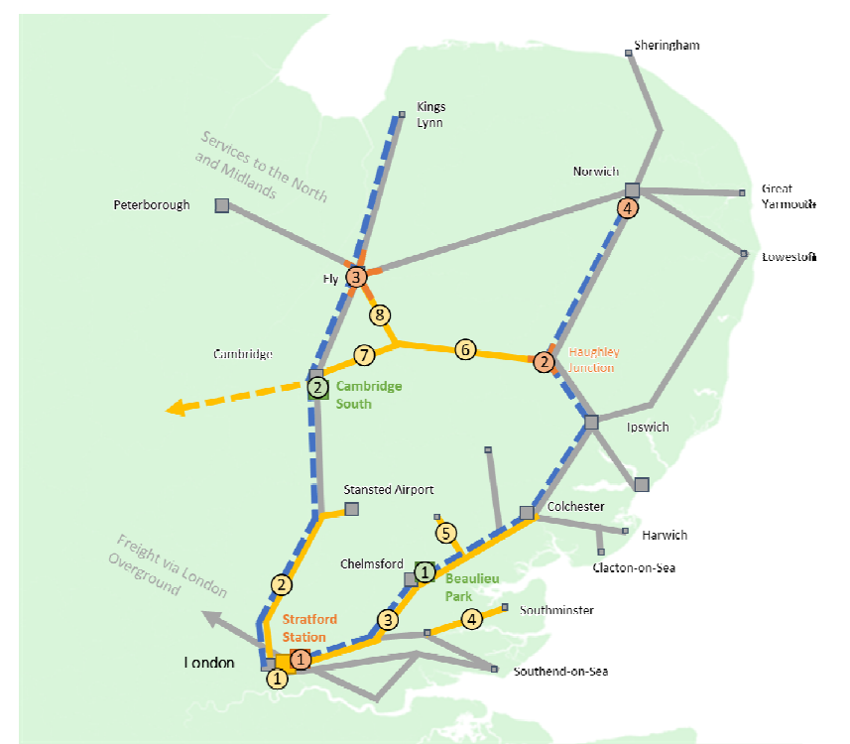
Known schemes
State of Rail Report

Slide 12
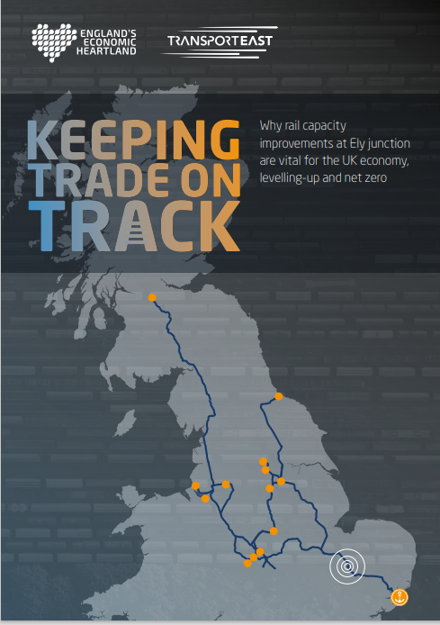
Ely and Haughley
Focus on
Still awaiting government announcement on Rail Network Enhancement Pipeline
Transport East and England’s Economic Heartland co-published ‘Keeping Trade on Track’ brochure for Ely and Haughley:
  8 reasons to invest
  Focus on national productivity, trade and carbon emissions
  Demonstrates widespread political and business support

Slide 13
Phase 2 proposals
Next Steps
Actions set out in 2023/24 Business Plan:
Regional rail engagement programme. A report that captures partner and stakeholders future vision for the role of rail in the East to 2050
Identify short-term rail investment opportunities for the region and integration opportunities with other modes (e.g. LTP4)
Incorporate the rail ambitions into the multi-modal regional connectivity studies (ongoing into 2024/25)
[for FY2024/25 – unless funding available earlier] Finalisation of connectivity studies and identification of medium / long term rail priorities as a Rail Plan, integrated with other transport network, focused on people and goods movement

Slide 14
Discussion points
Ongoing engagement with Suffolk Chamber TIG is key:
  What rail planning activity are you doing that could align with the regional rail work?
  What rail outputs would be of most use to members of this group?
  Any further questions or suggestions to ensure maximise value of TE Rail work?
Contact:
Andrew Summers
Chief Executive, Transport East
Andrew.Summers@suffolk.gov.uk
Links:
www.transporteast.org.uk
www.transporteast.org.uk/wp-content/uploads/State-of-Rail-Full-report-WEB.pdf

