Slide 1
Creating a Vision for the A14 Corridor
Something that goes beyond infrastructure…
.

Slide 2
Corporate priority
Suffolk County Council’s Corporate Strategy 2022-26 notes
“At the heart of Suffolk’s offer is the A14, a critical section in Britain’s premier trade route.” and states that the Council will deliver “a growth strategy for the wider A14 to enable community regeneration and job creation.”

Slide 3
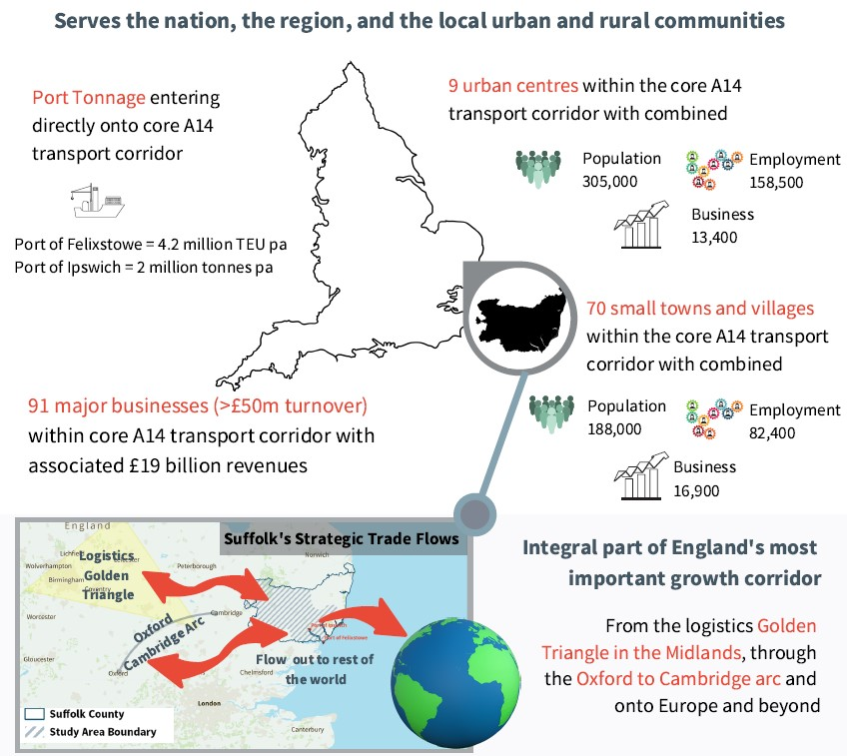
Context

Slide 4
Some policy drivers
Growing the economy
Levelling Up
Exporting
Freeports
County Deal
Transport East

Slide 5
The right approach
Vision
Engage & Consult
Options
Scope
Evidence
Test
Prioritise
Evaluate
Source- NIC October 2020

Slide 6
Success Indicators
Community buy-in
A single coordinated delivery plan for sustainable and inclusive growth
Increased investment
Recognition by government as a growth area
Growth in number of enterprises
Increased business rates/income
Increased number of scale ups
Increased productivity via GVA
Increased investment in R&D into area (Innovate UK investment)
Establishment of an ‘Growth Corridor Network’

Slide 7
Actions
To agree our ambition for growth
Engagement with LOCAL AUTHORITY partners via SCOLT & SPSL to ensure buy in to the project
Engagement with BUSINESS AND OTHER external partners and influencers
Engagement with Local community
Define the economic narrative
A SINGLE COORDINATED DELIVERY PLAN TO ARTICULATE OUR OFFER and ASK

Slide 8
Questions

